Slide 1
Collection

Slide 2
Introduction
The Java API provides several predefined data structures, called collections, used to store groups of related objects.
These classes provide efficient methods that organize, store and retrieve your data without requiring knowledge of how the data is being stored.
This reduces application-development time.

Slide 3
ArrayList
The collection class ArrayList<T> (from package java.util) provides a convenient solution to this problem—
it can dynamically change its size to accommodate more elements. The T (by convention) is a placeholder—when declaring a new ArrayList, replace it with the type of elements that you want the ArrayList to hold.

Slide 4
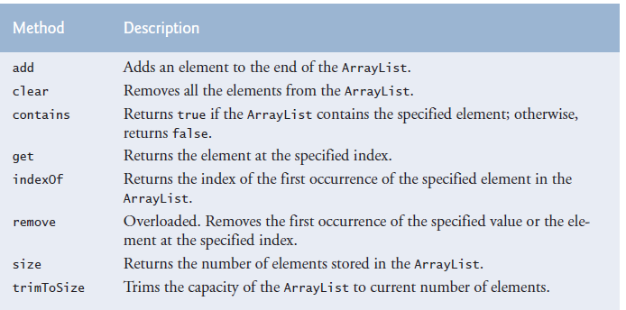
ArrayList Methods

Slide 5
Example
Figure 7.24 from Deitel

Slide 6
Using Object
In Java, all classes inherit from exactly one other class except Object which is at the top of the class hierarchy
Object variables can refer to objects of their declared type and any descendants
polymorphism
Thus, if the internal storage container is of type Object it can hold anything
primitives handled by wrapping them in objects. int – Integer, char - Character

Slide 7
ArrayLists and arrays
A ArrayList is like an array of Objects, but...
Arrays use [ ] syntax; ArrayLists use object syntax
An ArrayList expands as you add things to it
Arrays can hold primitives or objects, but ArrayLists can only hold objects

Slide 8
Auto boxing and unboxing
Java won’t let you use a primitive value where an object is required--you need a “wrapper”
ArrayList<Integer> myList = new ArrayList<Integer>();
myList.add(new Integer(5));
Similarly, you can’t use an object where a primitive is required--you need to “unwrap” it
int n = ((Integer)myArrayList.get(2)).intValue();
Now Java makes this automatic:
ArrayList<Integer> myList = new ArrayList<Integer>(); myList.add(5); int n = myList.get(2);

Slide 9
Generic Iterators
An Iterator is an object that will let you step through the elements of a list one at a time
List<String> listOfStrings = new ArrayList<String>(); ... for (Iterator<String> i = listOfStrings.iterator(); i.hasNext(); ) { String s = i.next(); System.out.println(s); }

Slide 10
Creating ArrayList - Examples
Specify, in angle brackets after the name, the type of object that the class will hold
Examples:
ArrayList<String> vec1 = new ArrayList<String>();
ArrayList<String> vec2 = new ArrayList<String>(10);
To create a generic Arraylist , use the <?> wildcard
Example: ArrayList<?> vec1 = new ArrayList<?>();

Slide 11
The End

